Slide 1
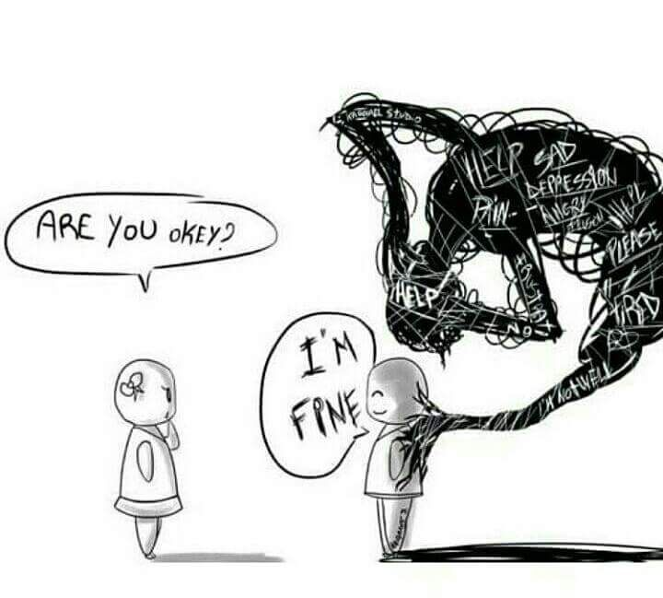

Slide 2
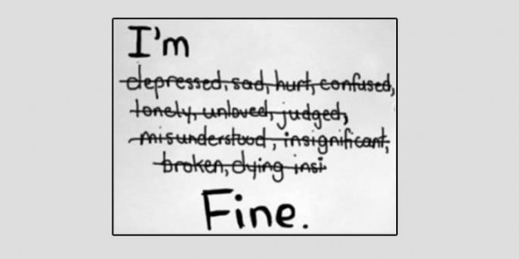
Depression and Anxiety

Slide 3
DSM-5 Criteria:
I. Feeling depressed throughout each day on most or all days

Slide 4
DSM-5 Criteria:
II. Lack of interest and enjoyment in activities you used to find pleasurable

Slide 5
DSM-5 Criteria:
III. Trouble sleeping, or sleeping too much

Slide 6
DSM-5 Criteria:
IV. Trouble eating, or eating too much, coupled with weight gain or weight loss

Slide 7
DSM-5 Criteria:
V. Irritability, restlessness, or agitation

Slide 8
DSM-5 Criteria:
VI. Extreme fatigue

Slide 9
DSM-5 Criteria:
VII. Unwarranted or exaggerated feelings of guilt or worthlessness

Slide 10
DSM-5 Criteria:
VIII. Inability to concentrate or make decisions

Slide 11
DSM-5 Criteria:
IX. Suicidal thoughts or actions, or thinking a lot about death and dying

Slide 12
National Institute of Mental Health:
Generalized anxiety disorder symptoms include:
Restlessness or feeling wound-up or on edge
Being easily fatigued
Difficulty concentrating or having their minds go blank
Irritability
Muscle tension
Difficulty controlling the worry
Sleep problems (difficulty falling or staying asleep or restless, unsatisfying sleep)

Slide 13
Facts about depression and anxiety:
Depression can be caused by:
A lack of hope
Overwhelming guilt
Other factors
Depression can feel like:
Hopelessness (1 Thess. 4:13)
Guilt – Prov. 22:8
There is a strong correlation between anxiety and depression

Slide 14
What does the Bible say about anxiety/depression?
Psalms are filled with depression language – Ps. 88:3-9; 13:1-3; 69:1-3
Biblical examples of DSM-5 criteria:
Feeling depressed throughout each day on most or all days (Psalm 13:2)
Lack of interest and enjoyment in activities you used to find pleasurable (Ecclesiastes 2:10-11)
Trouble sleeping, or sleeping too much (Luke 22:44-46)

Slide 15
What does the Bible say about anxiety/depression?
Biblical examples of DSM-5 criteria:
Trouble eating, or eating too much, coupled with weight gain or weight loss (1 Kings 19:4-8)
Irritability, restlessness, or agitation (Psalm 13:1-3)
Extreme fatigue (Psalm 69:1-3)
Unwarranted or exaggerated feelings of guilt or worthlessness (Psalm 38:1-6)

Slide 16
What does the Bible say about anxiety/depression?
Biblical examples of DSM-5 criteria:
Inability to concentrate or make decisions (1 Kings 19:4, 10)
Suicidal thoughts or actions, or thinking a lot about death and dying (1 Kings 19:4; Psalm 88:3-5; Ps. 13:3)

Slide 17
How do we deal with these emotions?
Sons of Korah prayed – Psalm 88; Jesus – Luke 22:44-46
David remembered God’s salvation (hope) - Ps 13:5-6
David was patient with God and hopeful for His deliverance - Ps 69
Cried out to God - Ps. 130:1-2
Common responses to deep sorrow/depression – prayer to God, patience with God, trust in God and hope in God.

Slide 18
How do we deal with these emotions?
Phil 4:6-7 – “Be anxious for nothing, but in everything by prayer and supplication, with thanksgiving, let your requests be made known to God; and the peace of God, which surpasses all understanding, will guard your hearts and minds through Christ Jesus.”

Slide 19
How do we deal with these emotions?
There is a strong correlation between our faith and our anxiety - Luke 12:25-29
If the cause of your depression is sin, you need to repent, and sorrow can be lifted (2 Cor. 7:8-11).

Slide 20
What about medications?
e.g. – Chronic Pain
Medications are an aid – they can and should be used to help with our conditions whether they be physical or mental.
They are not a substitute for prayer or God’s power.

Slide 21
Reminders for those struggling with anxiety/depression:
Our problems are not always fixed by a one and done prayer.
We all have chronic issues with sin and other anxieties and/or emotions.
Prov. 19:21 – “There are many plans in a man’s heart, nevertheless the Lord’s counsel—that will stand.”
Prov 24:6a – “For by wise counsel you will wage your own war, and in a multitude of counselors there is safety.”
Prov. 11:14 – “Where there is no counsel, the people fall; but in the multitude of counselors there is safety.”

Slide 22
Reminders for those struggling with anxiety/depression:
There is no shame in seeing a counselor, elder or advisor for your problems.
Ultimately, your battle is not against anxiety, depression, OCD, or PTSD. Your battle is against Satan.
Getting outside of ourselves helps us to forget about our own worries and emotions and help others in their time of need.

Slide 23
Reminders for those who have friends or relatives struggling with anxiety/depression:
We have a responsibility to bear the burdens of those who struggle with these emotions (Galatians 6:1-3).
As brothers and sisters in Christ, we have a responsibility to reaffirm our love for those who have turned from their sins - 2 Cor. 2:6-8

Slide 24
Reminders for those who have friends or relatives struggling with anxiety/depression:
We have a responsibility to remind one another of the hope we are striving for in Christ:
1 Cor. 15:19 – “If in this life only we have hope in Christ, we are of all men the most pitiable.”
Gal 5:5 – “For we through the Spirit eagerly wait for the hope of righteousness by faith.”
Col. 1:5, 27
1 Thess. 5:8-11

Slide 25
Reminders for those who have friends or relatives struggling with anxiety/depression:
1 Tim. 1:1
Titus 1:2
Titus 2:13
Titus 3:7
Heb. 3:6
Heb 6:11
Heb 6:18-19
Heb. 7:19
Heb 10:23
Heb 11:1
1 Pet. 1:13
1 John 3:3

Slide 26
Conclusion:
“And I heard a loud voice from heaven saying, ‘Behold, the tabernacle of God is with men, and He will dwell with them, and they shall be His people. God Himself will be with them and be their God. ⁴ And God will wipe away every tear from their eyes; there shall be no more death, nor sorrow, nor crying. There shall be no more pain, for the former things have passed away.’” – Rev. 21:3-4

